Slide 1

Customer
Modification
Click to Begin

Slide 2
Error!
Please follow the on-screen
instructions to continue.
Go Back

Slide 3
Complete
Please navigate to the next module
in the course to continue.
Restart Course

Slide 4
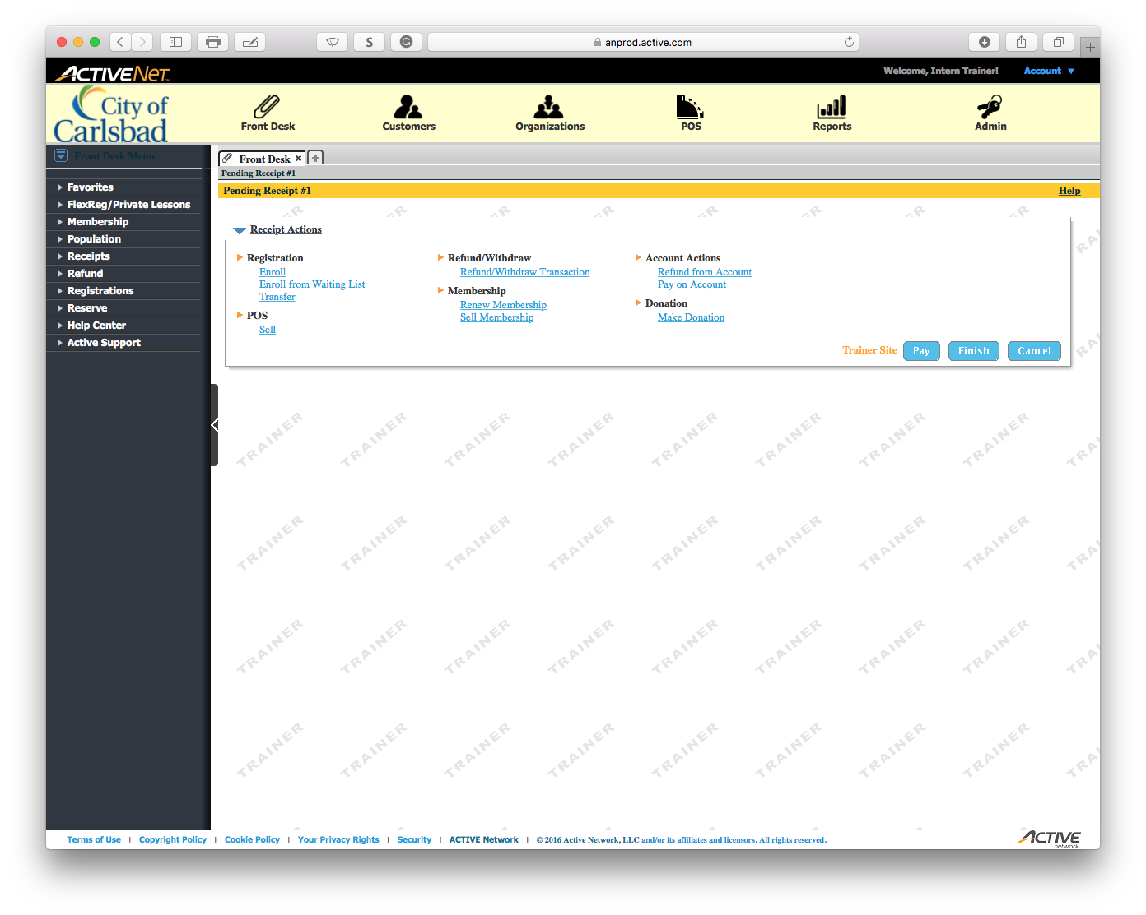
Tip:
Open the Customers module

Slide 5
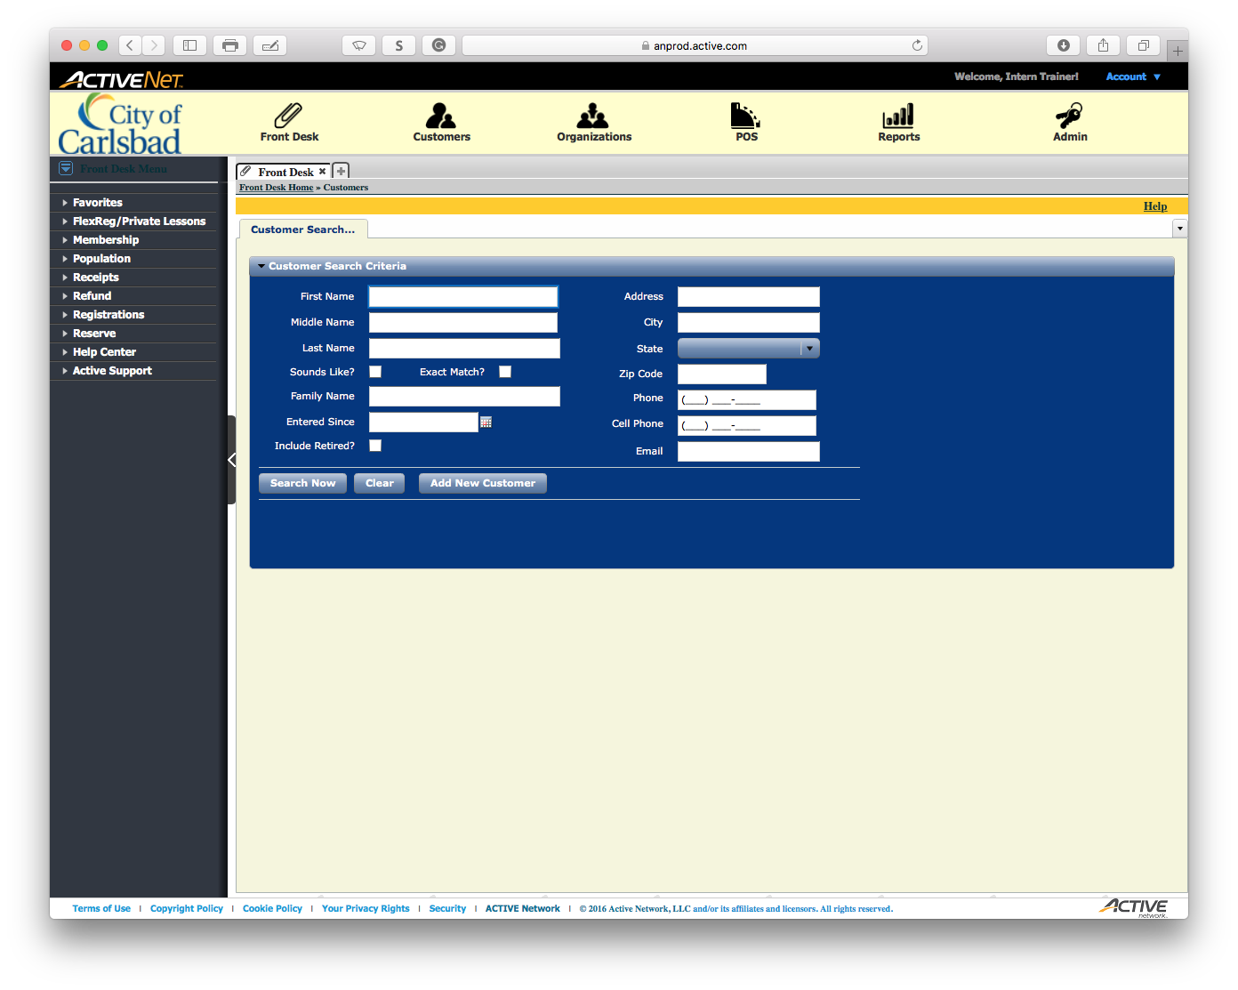
Tip:
Enter the First Name of the client

Slide 6

Tip:
Enter the Last Name of the client

Slide 7

Tip:
Search for all matching results

Slide 8
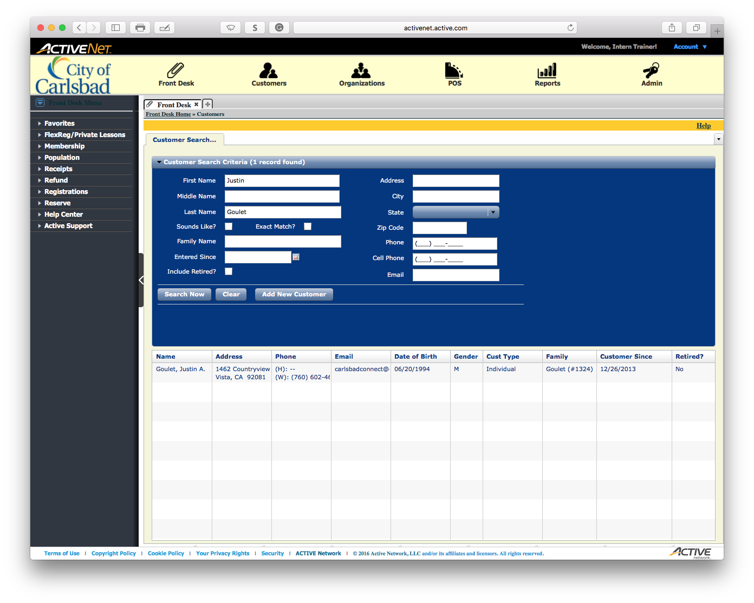
Tip:
Select the correct client from the list

Slide 9
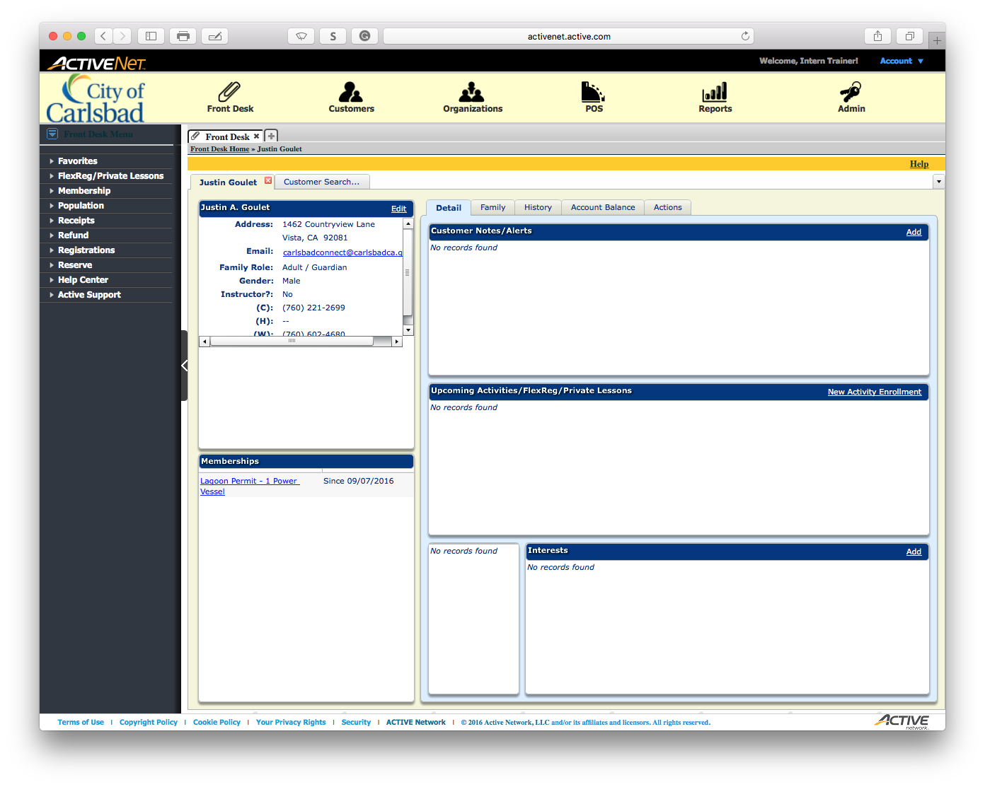
Tip:
Click Edit to edit the client’s info

Slide 10
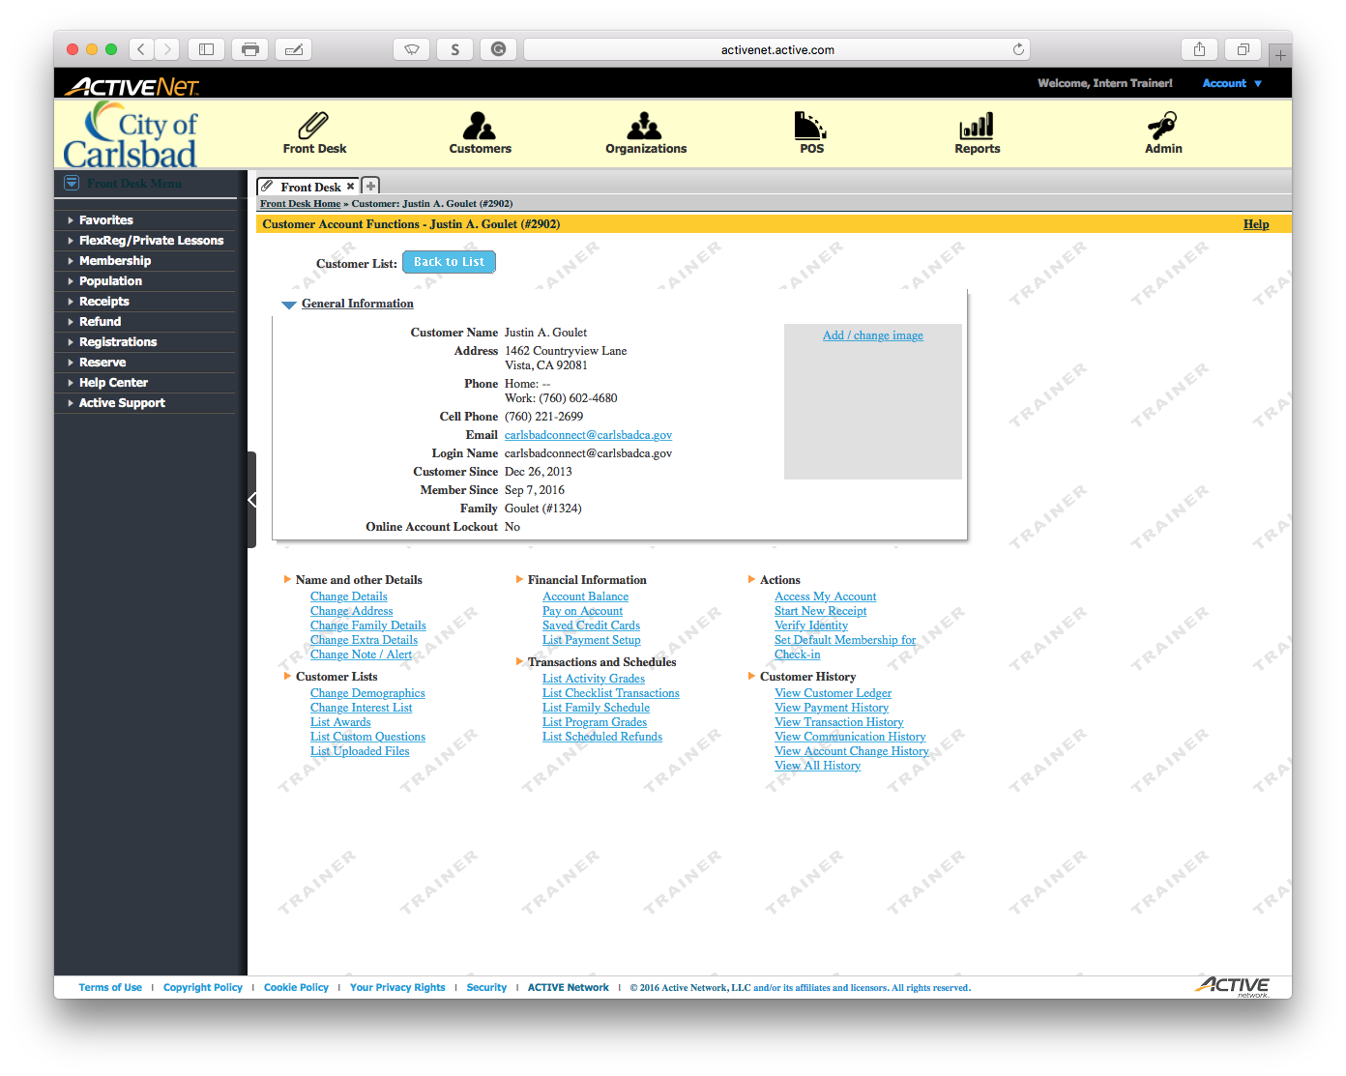
Tip:
Click to change the details of the client

Slide 11
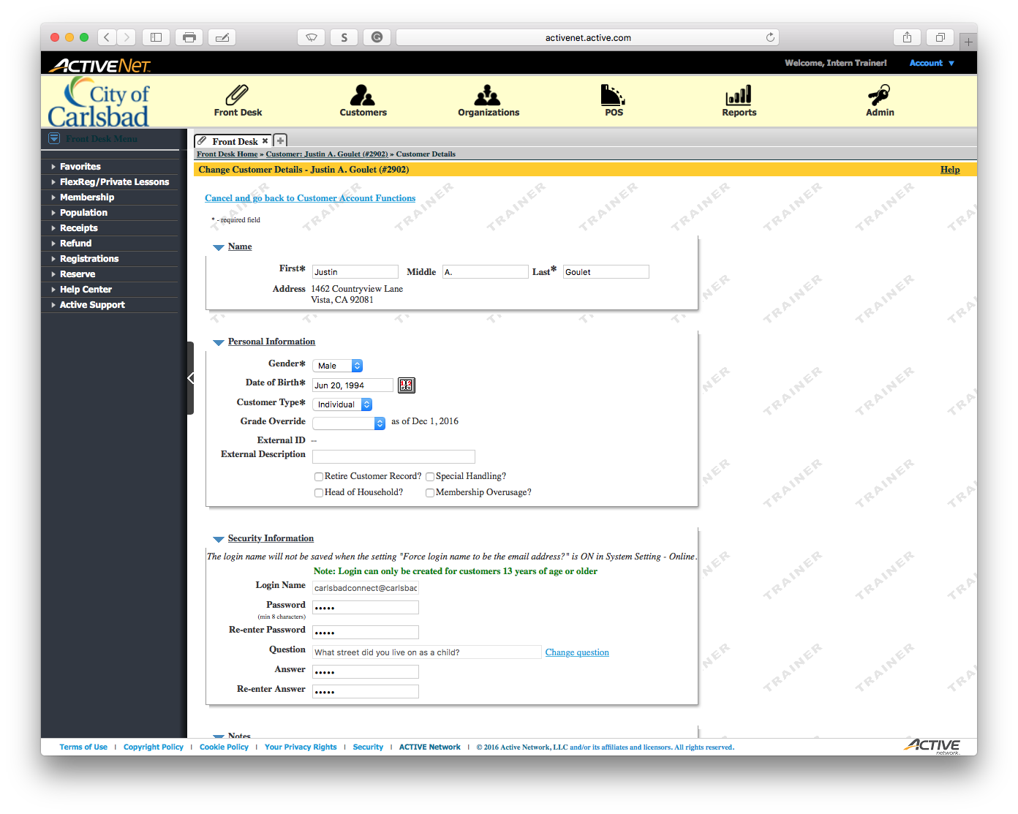
Tip:
Click the calendar to modify the client’s birthday.

Slide 12
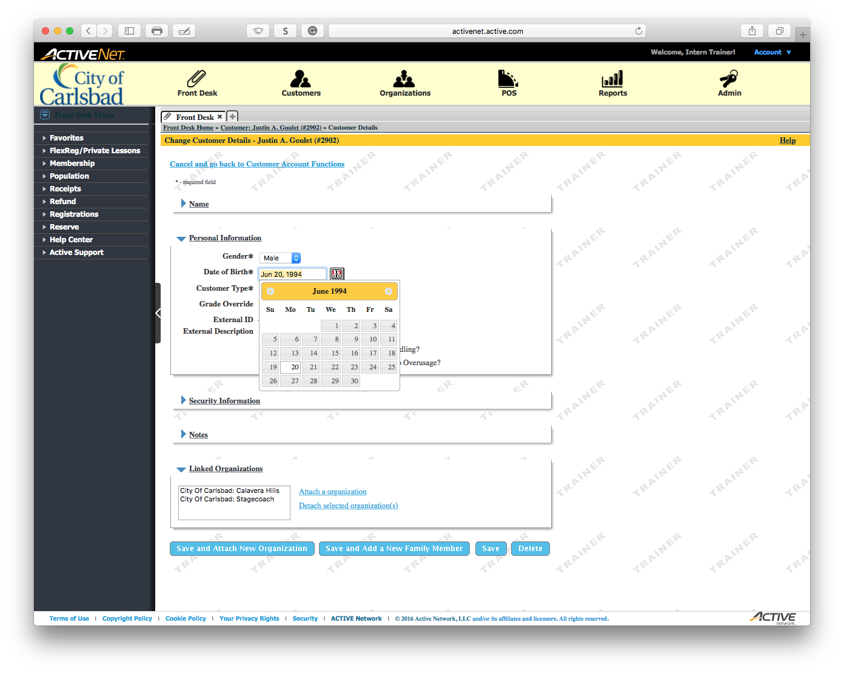
Tip:
Change the birthday to June 1, 1994

Slide 13
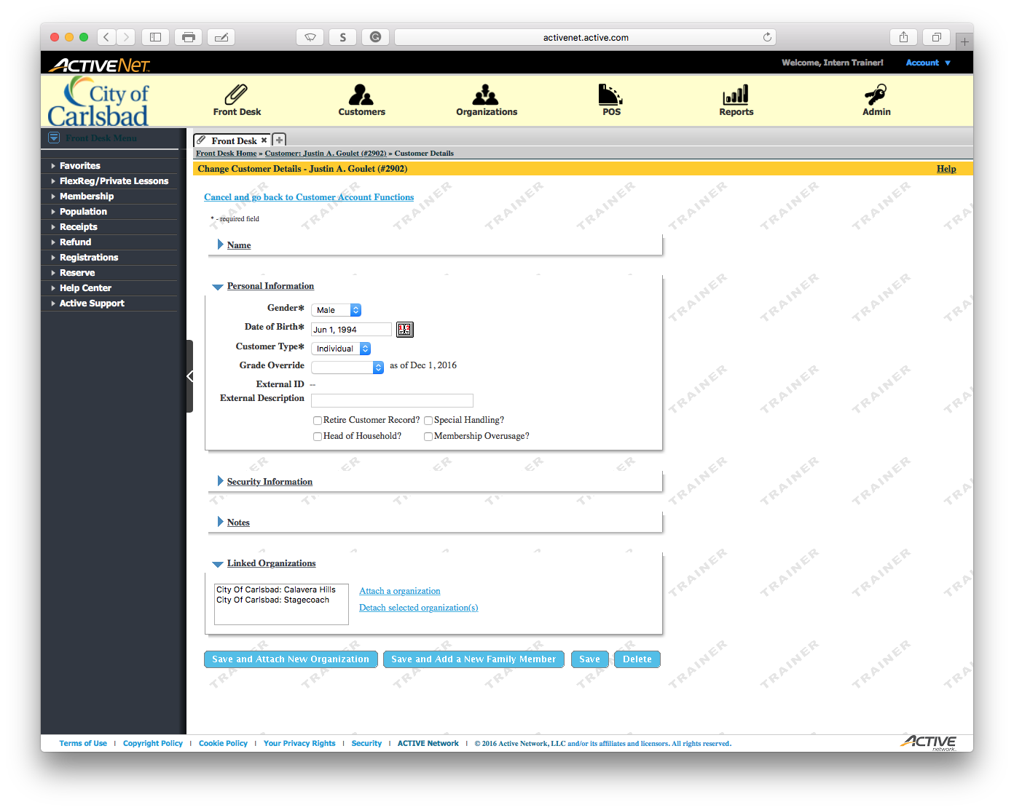
Tip:
Expand the Notes section

Slide 14
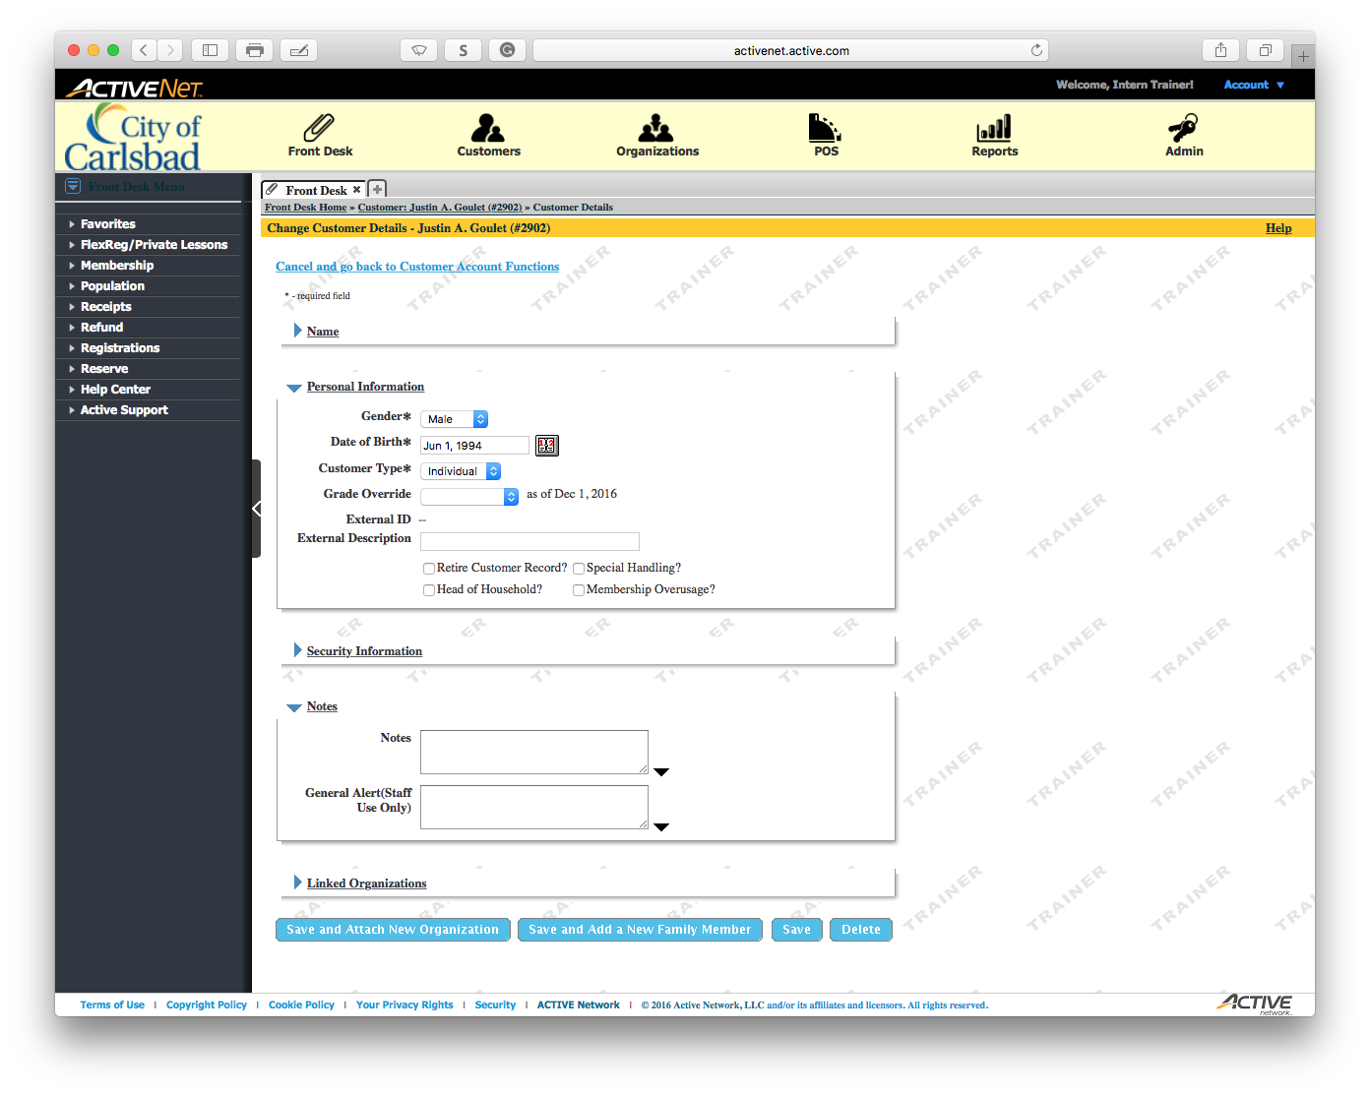
Tip:
Enter the notes for the change:
Notes should include your username, date of change, and what item was changed

Slide 15

Tip:
Click to Save the change and notes

Slide 16

Tip:
To finish, return to the Front Desk module

